Slide 1
Samsung Innovation Campus

Slide 2
TEAM NO-01
INTRODUCTION
PROJECT NAME - E-GOVERNANCE CHAT SUPPORT
NAME | ROLE
THARUN B | TEAM LEADER
BHASKAR REDDY B R | MEMBER
VARSHITHA A | MEMBER
SAVITHA G K | MEMBER
DEEPASHREE G J | MEMBER

Slide 3
PROBLEM STATEMENT
DOMAIN : E - GOVERNANCE
E – GOVERNANCE CHAT SUPPORT
E-governance chat bots are computer programs
designed to interact with citizens and provide
assistance with various government-related services and information.
With the increasing use of digital channels and the need for more efficient
government services, e-governance chat bots have become
an effective tool for improving citizen engagement and service delivery.
They are used in various areas such as tax payment, citizen registration,
license renewal, and more

Slide 4
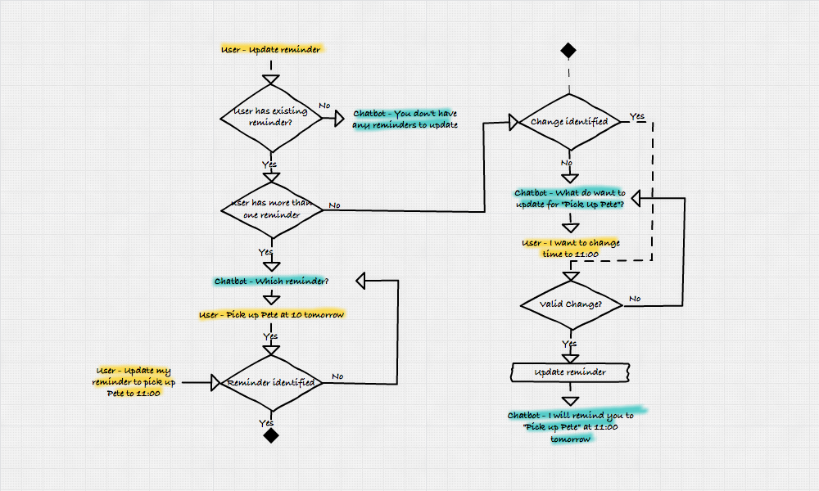
DESIGN THINKING

Slide 5
